Slide 1
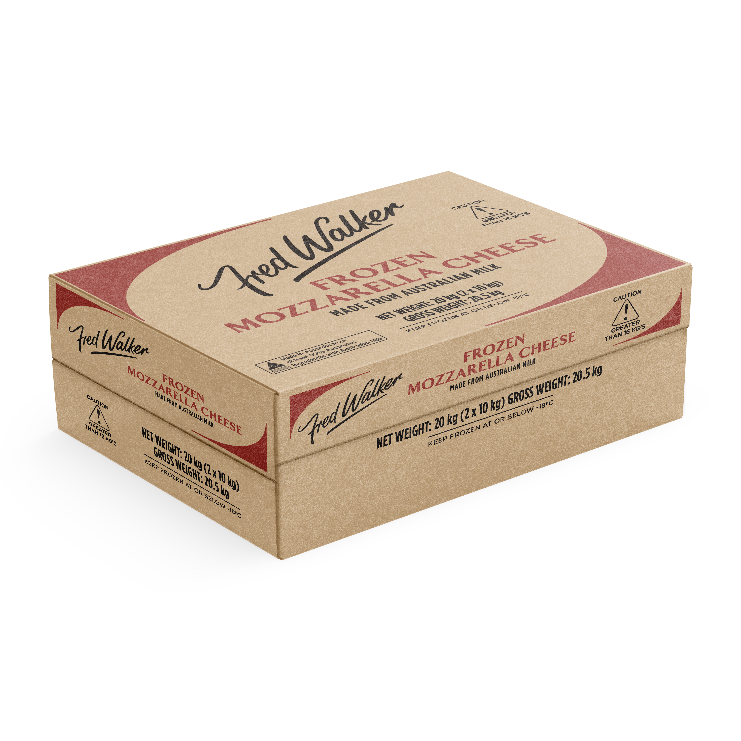
Available to Order: W/C 1/07/24
List Price: POA
Code: 1017768
EAN: 9300639619040
TUN: 19300639619047
Fred Walker Frozen Mozzarella is an Australian made stretched Mozzarella made from whole milk. It is a creamy, milky, mild flavored cheese.
Units Per Carton | Cartons Per Layer | Layers Per Pallet | Cartons Per Pallet | Max Shelf Life | MOQ
2x10kg | 8 | 5 | 40 | 365 Days | 80 Cartons

Slide 2
Cartons per pallet:
40 (chimney stacked, centre cavity allows for more uniform freezing and thawing)
Thawing Instructions at 1 to 4C°:
For optimal results thaw 20kg cartons individually (unstacked with space/airflow between) over 2 to 3 days and shred immediately.
Individual 10kg blocks will thaw overnight.
OR
Place pallet in 2 to 4°C storage to thaw over 2 to 3 weeks.
Post Thaw Instructions:
Thawed mozzarella to be stored between 1 to 4°C, the lower the temperature the better to minimise body breakdown.
Optimal conditions for shredding are 0 to 2°C .
Customers will need to monitor based on their own coolroom temp/air flow
Use within 7 days of thawing.

